Slide 1

Steganography
1

Slide 2
What’s the difference between hiding a message and encrypting it?
2

Slide 3
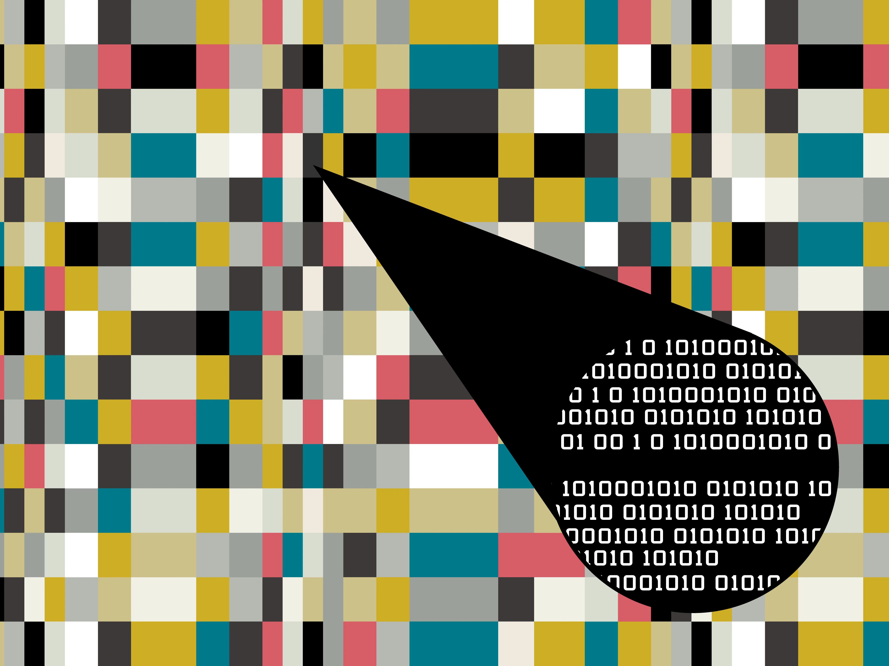
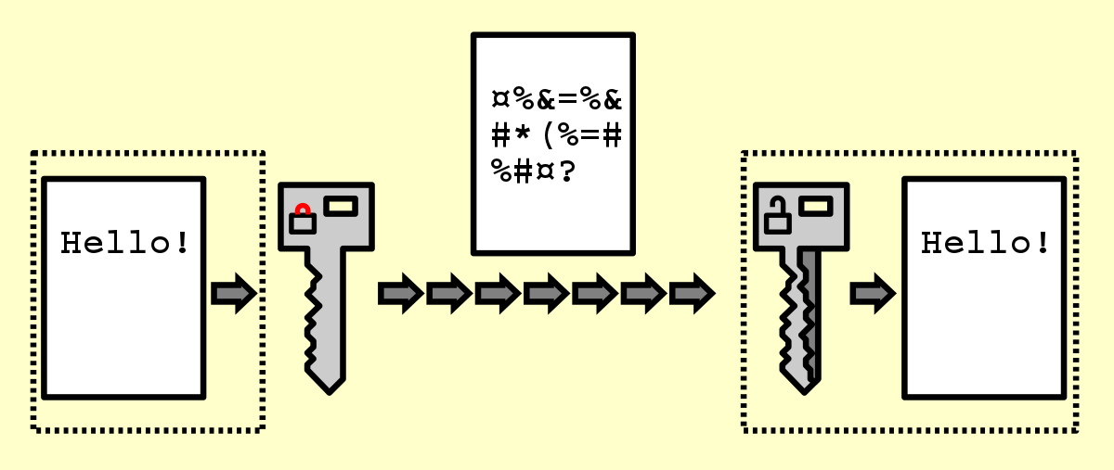
Steganography
VS
Encryption
3

Slide 4
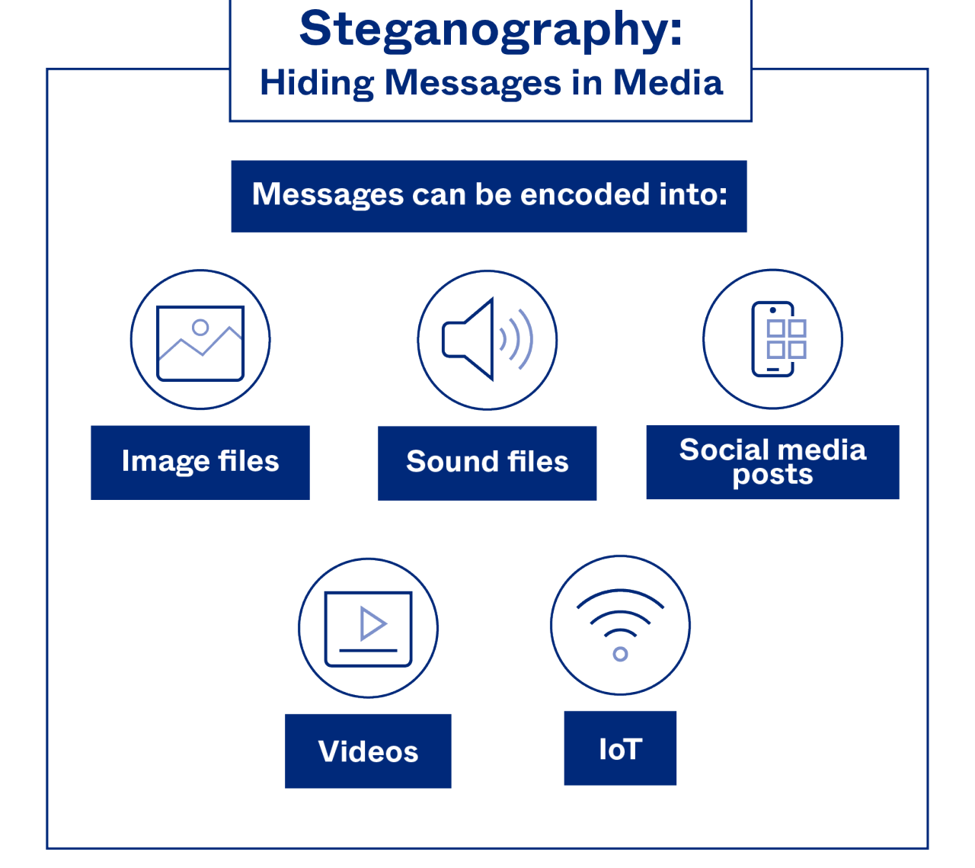
What is steganography?
Steganography = hiding a message inside another ordinary medium (image, audio, video, text)
Goal: hide the existence of the message.
Often combined with cryptography (crypto scrambles; stego hides)
4

Slide 5
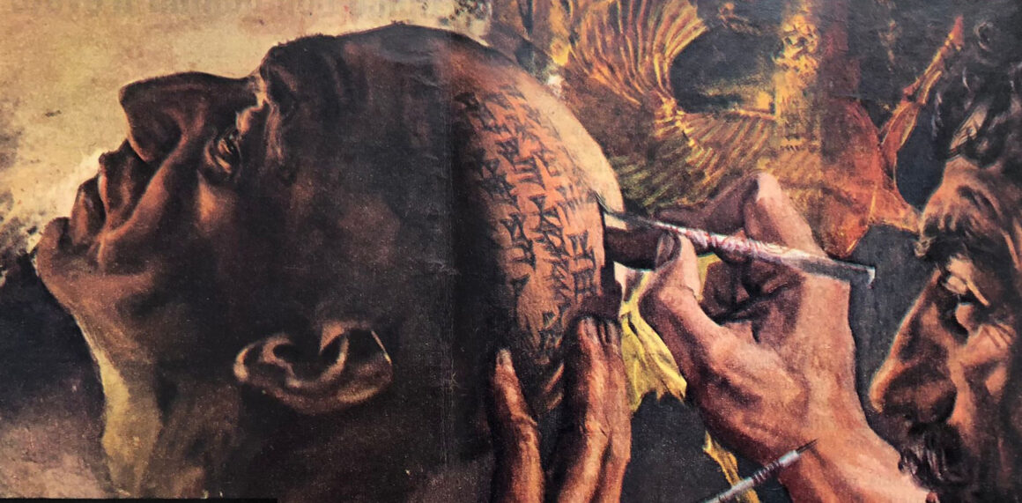
Origins
First known example: Herodotus, Histories (Book V).
Story: A slave’s head was shaved, scalp tattooed with a secret message, hair regrown, then sent to deliver it.
5

Slide 6
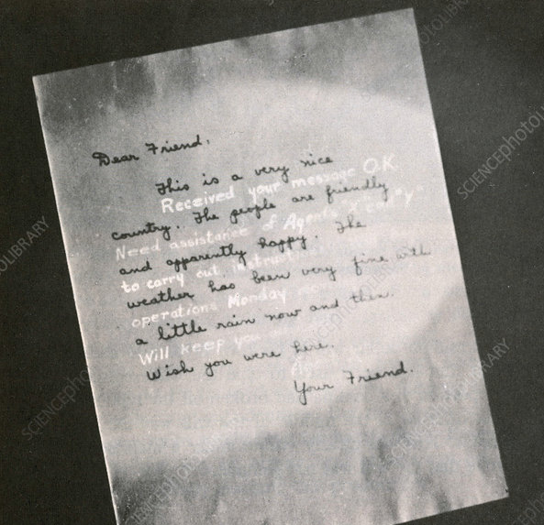
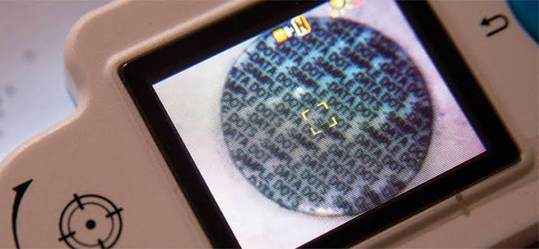
Pre-digital methods
Invisible ink
Microdots (tiny photos with reduced documents)
6

Slide 7
Textual steganography
E.A. Poe "An Arcostic"
Elizabeth it is in vain you say
"Love not" — thou sayest it in so sweet a way:
In vain those words from thee or L.E.L.
Zantippe's talents had enforced so well:
Ah! if that language from thy heart arise,
Breath it less gently forth — and veil thine eyes.
Endymion, recollect, when Luna tried
To cure his love — was cured of all beside —
His folly — pride — and passion — for he died
7
Notes:
Note for andy: dutch national anthem also has a hidden arcostic: first letter of each verse spells WILLEM VAN NASSOV

Slide 8
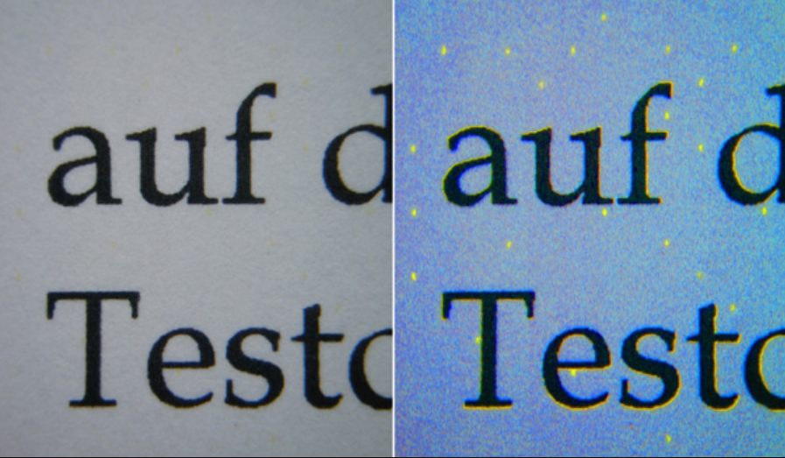

Why do we still use it?
watermarking & fingerprinting protect ownership and trace leaks
printers, cameras, and digital documents embed invisible IDs
avoids detection where encryption is blocked or suspicious
helps individuals communicate safely under surveillance
Printer tracking dots
real tools used in education, research, digital forensics, and Capture the Flag competitions
OpenStego, Steghide, SilentEye, ExifTool, StegSolve / zsteg
Watermarking
8
Notes:
UV light used to make the dots clearly visible

Slide 9




Malicious uses
Stegano Exploit Kit (2016)
→ Malicious JavaScript hidden inside banner ad images, infecting users silently
Operation ShadowHammer (2019)
→ Malware embedded inside official ASUS software updates, digitally signed and trusted
SolarWinds Attack (2020)
→ Hidden C2 commands stored inside benign-looking XML files to evade detection
Magecart Attacks (ongoing)
→ Payment-skimming scripts concealed within SVG graphics on e-commerce checkout pages
9

Slide 10
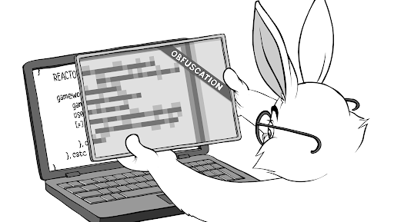
A picture is worth a thousand words
10

Slide 11

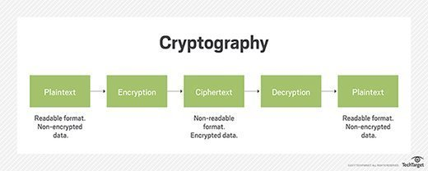
Cryptography
11

Slide 12
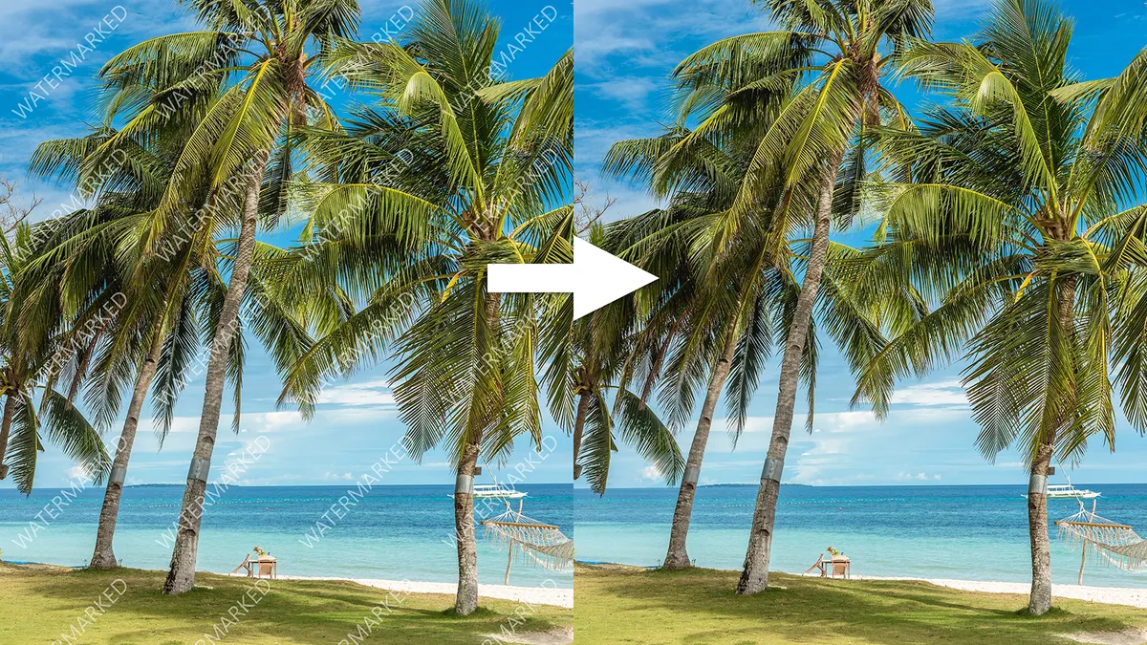
Digital Watermarking
12

Slide 13
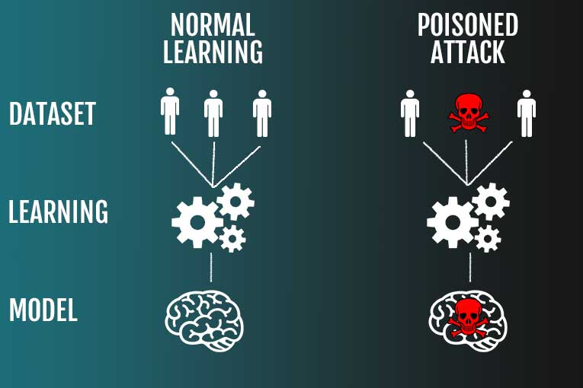
Data Poisoning
13

